Slide 1
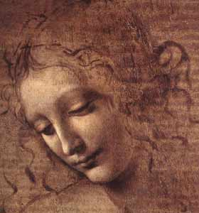
Focus Question #3 How Did Artists Help Spread the Ideas of the Renaissance
Chapter 2 Social Studies 8

Slide 2
Artists Spread Renaissance Ideas
People today still regard Renaissance Art to be the finest artwork in the world’s history.
Artists matched their style to changing worldviews, especially to suit humanism.
Humanists again looked at Islamic, Greek and Roman writing, art and architecture for inspiration. (life on earth was to be enjoyed)
Artists style became more humanist, which supported the ideas of humanism and the value and dignity of life on earth. (while retaining a religious subject matter)

Slide 3
Early Renaissance Art
Early Renaissance art focused on religious themes, paintings were very lifelike due to the knowledge of the human body.
Early Renaissance art also became more natural because artists wanted to paint the world as it actually existed.
Artists were seen as craftsman or artisans.

Slide 4
Later Renaissance Art
As the Renaissance moved along, paintings began to depict Greek and Roman myths.
Also, because of humanism and the value of self and life, wealthy people began to pay artists to paint likenesses of themselves.
Art became a means of income. Artists could make good money from their work.
Artists began taking credit for their work by signing it, or incorporated their own likeness as a secondary figure.

Slide 5
Renaissance Artists
Better idea of the human body because of all the study that was being done. This made their images more realistic.
Became more confident in their work as more people wanted to own them
Travelled more, shared ideas, developed better techniques
Words showed personal reflection of how they saw the world.

Slide 6
Renaissance Artists
Gained more freedom over what they painted and created
Became respected as creative geniuses
Paid more for their works
Gained status in the class system
Were treated as important contributors to society (like todays celebrities)
Game

Slide 7
Show What You Know!
How well could you answer focus question #3?
How did artists help spread the ideas of the Renaissance?

